Slide 1
Final Project Details User Generated Content and Product Preference Networks
Text Analytics
Nov 18, 19, 2019

Slide 2
Topics for Final Project
You are a consultant to a brand, organization, politician, etc.
Many possibilities for topic selection. E.g.,
Analysis of competing brands or products
Airlines, automobiles, hotels, smartphones, etc.
Track events (e.g., political) or marketing campaigns
Whether social mentions reflect the intended messages
Predict outcomes from social data including images
E.g., box office revenues, crowdfunding success, engagement, etc.
Develop a crowdsourced recommendation system
Provide actionable insights from social mentions using unstructured data analytics
Copyright Anitesh Barua 2019

Slide 3
10 Minute Meetings (in Class) With Each Group on 11/20 & 11/21
Come up with 2-3 ideas for discussion
Have answers to the following questions:
(i) What is the problem? Why does it matter?
(ii) Likely source(s) of data (must be primary, and not secondary sources like Kaggle)
(iii) What type of analysis will be done?
(iv) What are likely outcomes?

Slide 4
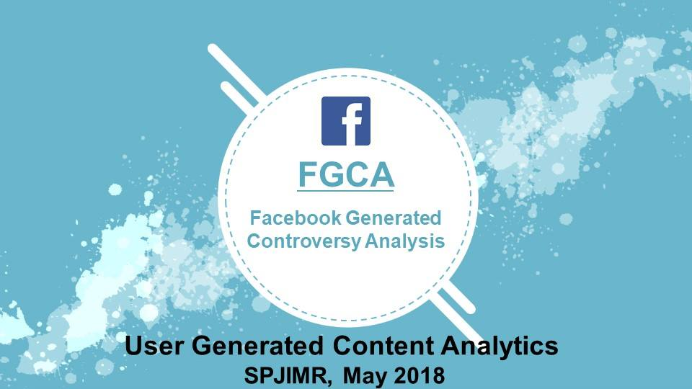
Exemplar Project 1 (Completed in 3 days)

Slide 5
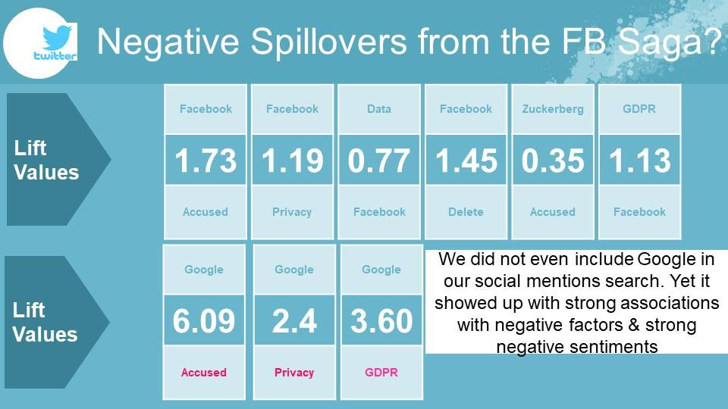
Simple, But A Powerful Message

Slide 6
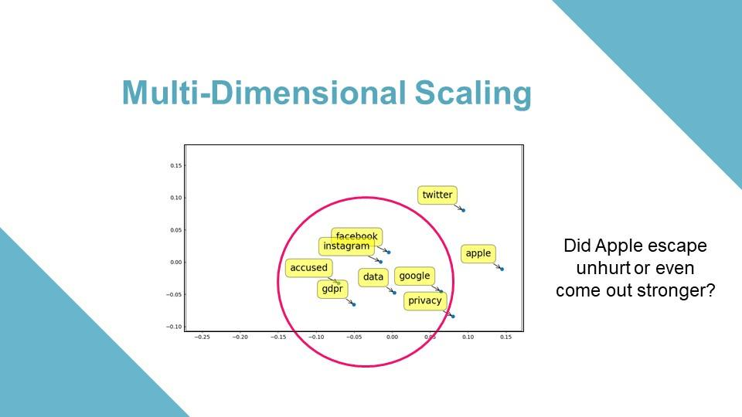
The Aha Moment(s)

Slide 7














Exemplar Project #2: Discovering a Winning Formula from User Generated Content

Slide 8
PROBLEM STATEMENT
Comedy %?
What are the ingredients for a Superhit Sci-Fi Television Series?
Can User Reviews of TV Series on Social Media be used to find a model that predicts the Success of a New Television Series even before it is aired?
Mystery %?
Action
%?
Thriller %?
Horror %?
History %?
Drama %?
Sci- fi %?
Romance %?
A Superhit Series!
Crime %?

Slide 9



TOPIC MODELING
Sci-Fi
Cast
Cosmic Space
Comedy
Horror
Human & Social
Cast | Cosmic Space | Comedy | Horror | Human & Social Angle
Fan | Science | Funny | Dead | World
Actors | Years | Humour | Evil | Prisoner
Characters | Space | Comedy | Zombie | Blacks
 | Star | Hilarious | Dinosaurs | Woman
 | Time | Cartoon | Blood | Human
 | Mind | Jokes |  | Gay
 |  |  |  | Society
 |  |  |  | Village
 |  |  |  | Power
83% accuracy in predicting hits/flops from content

Slide 10
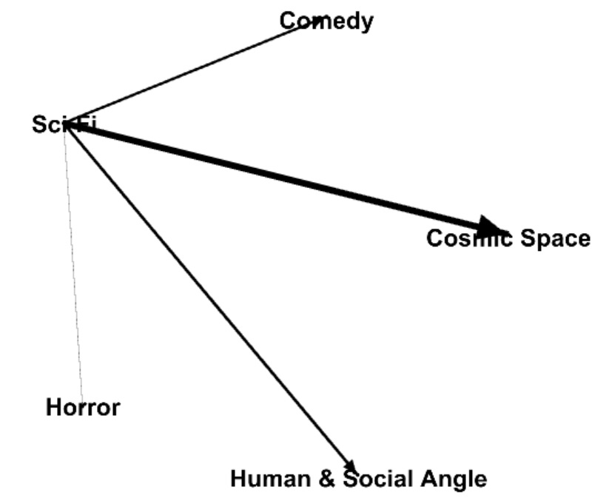
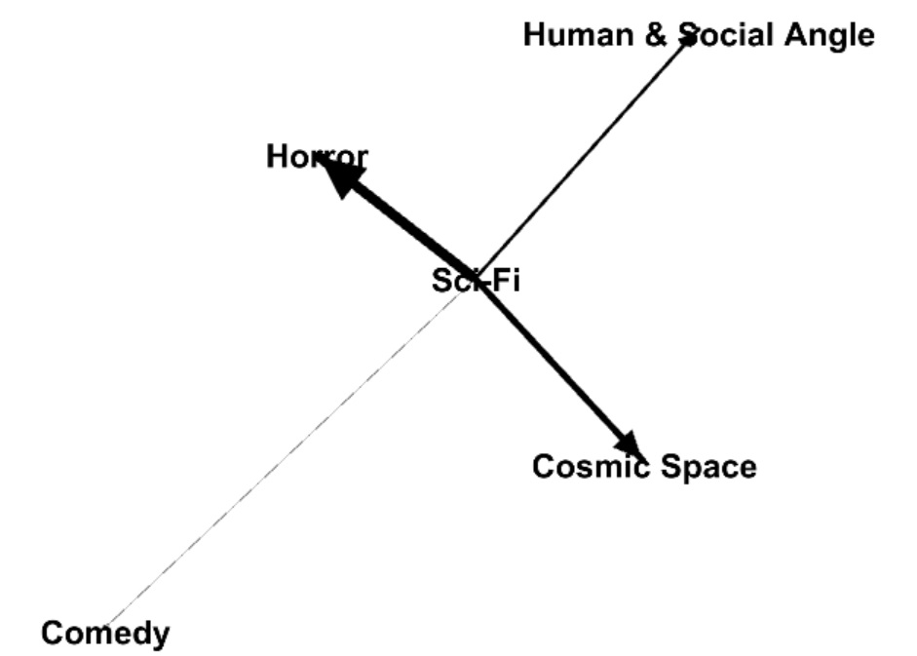
VISUALIZATION USING GEPHI
HITS
FLOPS

Slide 11
Key Steps
Collect mentions
Analyze important words
Calculate lifts
Web Scraper, other scripts
Twitter API python script,
Youtube scraper, etc.
Brand maps
(MDS)
Sample steps only, may differ by project
Topic (e.g., for image analytics)
Business Insights:
Examples (for products)
Real competitors (brands)?
What people talk about
Which attributes matter the most
Which are positive (negative)?
Branding & marketing implications
Sentiment Analysis
Cosine Similarity
Topic modeling
Copyright Anitesh Barua 2019

Slide 12
Predicting Business Outcomes From User Generated Content
Can UGC (e.g., product reviews) predict business outcomes such as sales and market share?
Often users mention competing products in reviews
Can we extract preference information?
Can we draw product comparison (or preference) networks?
Can such networks help predict business outcomes?
Slides based on Zhang et al. (2013)

Slide 13
From Product Comparisons to Preference Networks
“The B&W P7 are high on my favorite list after the H8 by B&O. I also like the new P5 because their sound is almost as good as the P7 without the bulk.”
“I just love the luxury, style and performance of the Audi A6; the Lexus GS300 is a nice reliable car and a very good value, but lacks the coolness factor.”
Sentiment score
= +4
Weight = 4-2 = 2
+2
+3
4-3 = 1
Audi A6
+4
Lexus GS300
“I need a super reliable car with the great creature comforts, and while the A6 is a wonderful car, it’s quite expensive; the Lexus GS300 isn’t exactly the lap of luxury, but really fits the bill for me in every way.”

Slide 14
The Main Idea
Product preference networks
Arrows indicate implicit preferences
Relative desirability of a node
A product review (as discussed in the article)
Must mention two or more products
Has two sentiment scores (s₁ and s₂) for two products 1 and 2 respectively.
Arrow between the two product, tip ends on the product with higher sentiment score
Difference in sentiment scores becomes the weight of the arrow
How to put a score on each node which represents its desirability

Slide 15
What Metric Can Capture the Relative Importance of a Product?
Create a network of product preferences
PageRank is one possibility
Developed by Larry Page, Serge Brin & Rajiv Motwani at Stanford
A variation of the good old eigenvector algebra
Based on how many web pages refer to a particular web page.

Slide 16
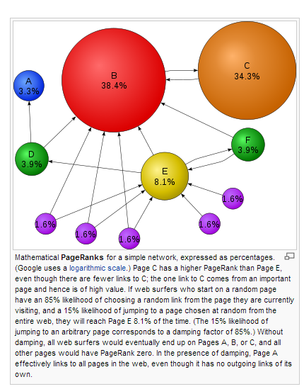
PageRank to the Rescue
If many web pages refer to a page, the latter must be important
If the referring pages are referred to by many other pages, the effect is stronger
Source: Wikipedia

Slide 17
The $825B Algorithm?
Web page x₁
Links to:
Page x₂
Page x₃
Page x₄
Web page x₃
Links to:
Page x₁
Web page x₂
Links to:
Page x₃
Page x₄
Web page x₄
Links to:
Page x₁
Page x₃
As if a page transfers its importance to other pages
E.g., x₁ transfers 1/3 of its importance to each of x₂, x₃ & x₄
Graph representation, transition matrix, PageRank calculation
Interpretation from a probabilistic perspective

Slide 18
Problems Galore …
Web page x₁
Links to:
Page x₃
Web page x₃
Links to:
None
Web page x₂
Links to:
Page x₃
What does the transition matrix look like?
Show PageRank Calculations
Source: R. Remus

Slide 19
Problem Cases (Contd.)
Web page x₁
Links to Page x₂
Web page x₃
Links to:
Pages x₄ & x₅
Web page x₅
Links to:
Pages x₃ & x₄
Web page x₂
Links to Page x₁
Web page x₄
Links to:
Page x₃ & x₅
What did Brin et al. suggest as a solution?
Source: R. Remus

Slide 20
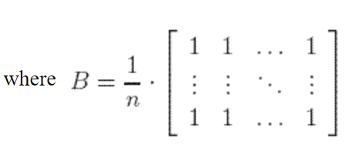
Brin et al.’s Solution
Replace the original transition matrix A by
M = (1-p). A + p.B
where 0 < p < 1 (often taken to be a small number, like .1)
What is the interpretation of this version of the transition matrix?
How does this help?
Source: R. Remus

Slide 21
Weighted PageRank
Not all incoming links are created equal
Different ways to create weights on links
networkx library in python can calculate weighted PageRank scores

Slide 22
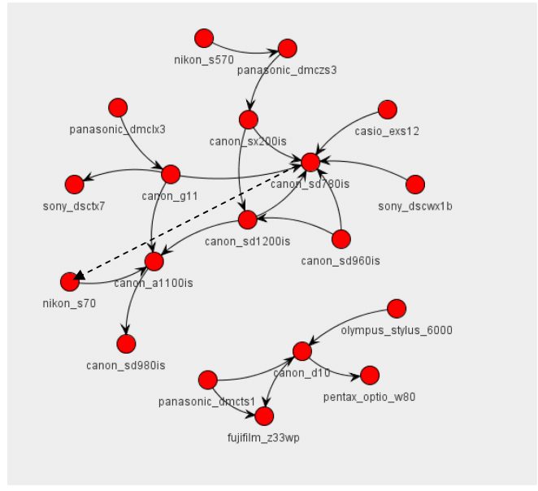
Real World Implications

